Slide 1







Software University: Learning Program
Become a Software Engineer and Start a Job
SoftUni Team
Technical Trainers
Software University
https://softuni.bg

Slide 2

Table of Contents
Welcome to SoftUni
SoftUni Partners
SoftUni Trainers
Learning Paths and Opportunities

Slide 3
Questions?
sli.do
#fund-common

Slide 4
The SoftUni Family
Quality Digital Education for Thousands

Slide 5
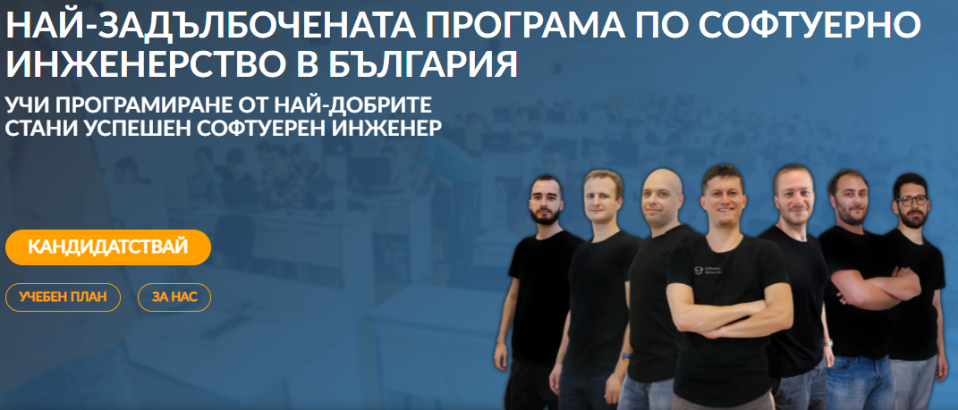
Software Engineering Learning Program
The "Software University" learning program @ SoftUni
Become a professional software engineer in ~ 1-2 years
Professions:
C# / .NET Web Developer
Java & Spring Web Developer
JavaScript Web Developer
Python & Django Web Developer
QA Engineering (Software Quality Assurance & Test Automation)
Curriculum: https://softuni.bg/curriculum

Slide 6

SoftUni Partners
Tech Companies, Who Support SoftUni

Slide 7

Indeavr
Business and technology services company
Business application development
Infrastructure services
Collaboration services
Looking for trainee and junior .NET Developers
https://www.indeavr.com/en/careers

Slide 8

Infragistics
Providing solutions to accelerate design, development, and collaboration
Design, development & UX
Angular, JavaScript, ASP.NET, WPF, Xamarin
Bulgaria, USA, UK, Japan, Uruguay, India
https://www.infragistics.com

Slide 9

Motion Software
Development of innovative Web and mobile projects
40 clients in 15 countries
Financial apps, blockchain, e-commerce, artificial intelligence, big data
Friendly community and availability for 100% remote work
https://motion-software.com

Slide 10

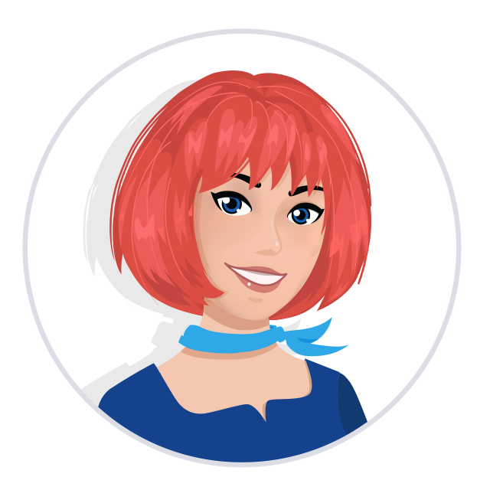
Postbank
One of the top banking institutions in Bulgaria
Employer of the year for 2017
Member of the Eurobank Group with € 58 billion of assets
Serious investments in digitization
The first bank credit botchat – EVA
https://www.facebook.com/evapostbank
https://www.postbank.bg/Za-nas/Careers

Slide 11

Draft Kings
Award-winning sports betting solutions
iGaming platform
Looking for developers, mostly with JS and .NET
https://www.sbtech.com/careers

Slide 12

SmartIT
12+ years programming business-orientated solutions
ERP Systems
Mobile iOS & Android
Server Management
Sofia, Plovdiv, Varna and Ruse offices
Looking for .NET developers
https://www.smartit.bg

Slide 13




Software Group
Integration solutions for financial institutions
Provide digital transformation
Discovering Potential
Driving Innovation
Unlocking Opportunities

Slide 14

SuperHosting
The largest hosting company in Bulgaria
Hosting
Domains
WordPress Hosting
VPS Servers
SSL Certificates
E-Commerce
Offering a complete solution
Top-quality support
Top-qualified team
Leading technical equipment

Slide 15




XS Software
Gaming company, founded back in 2005 in Sofia
Over 50,000,000 registered players
Introduced the first browser games in Bulgaria
Looking for PHP Game Dev

Slide 16

Coca-Cola HBC – Bulgaria
Coca‑Cola HBC is one of the world's largest bottlers of brands from the Coca‑Cola company
CCHBC started operations in Bulgaria in 1992 and since then is one of the biggest contributors to the local economy
Global company with over 30 thousand engaged people
https://bg.coca-colahellenic.com

Slide 17







SoftUni Diamond Partners

Slide 18



Educational Partners

Slide 19

The Trainers
The Trainers for the Software Engineering Program

Slide 20
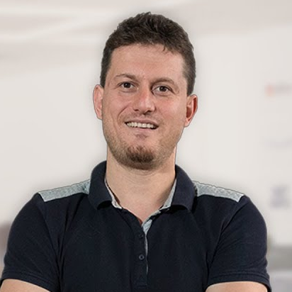
Svetlin Nakov, PhD
Co-Founder of SoftUni
Training & Inspiration Manager @ Software University (SoftUni)
20+ years as software developer
10+ years experience as trainer
Author of 8 programming books
Speaker at hundreds of events
Web site & blog: nakov.com

Slide 21
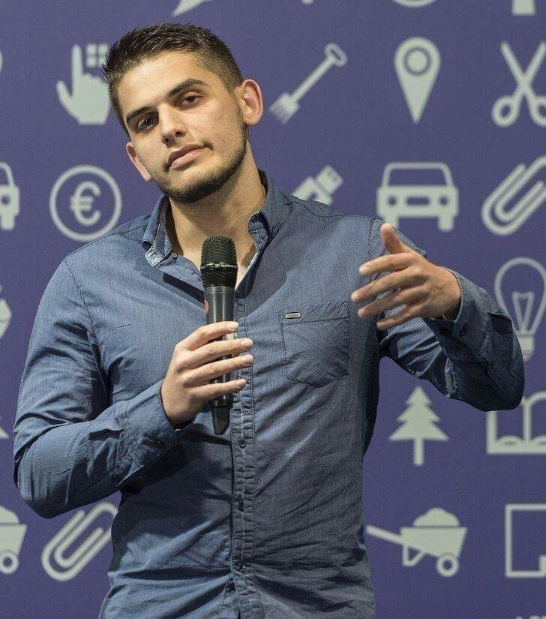
Viktor Dakov
Senior Developer SDE 3, Nuvolo
Worked at Amazon
John Atanasoff award
Participated in many programming contests
6+ years of experience as a developer

Slide 22
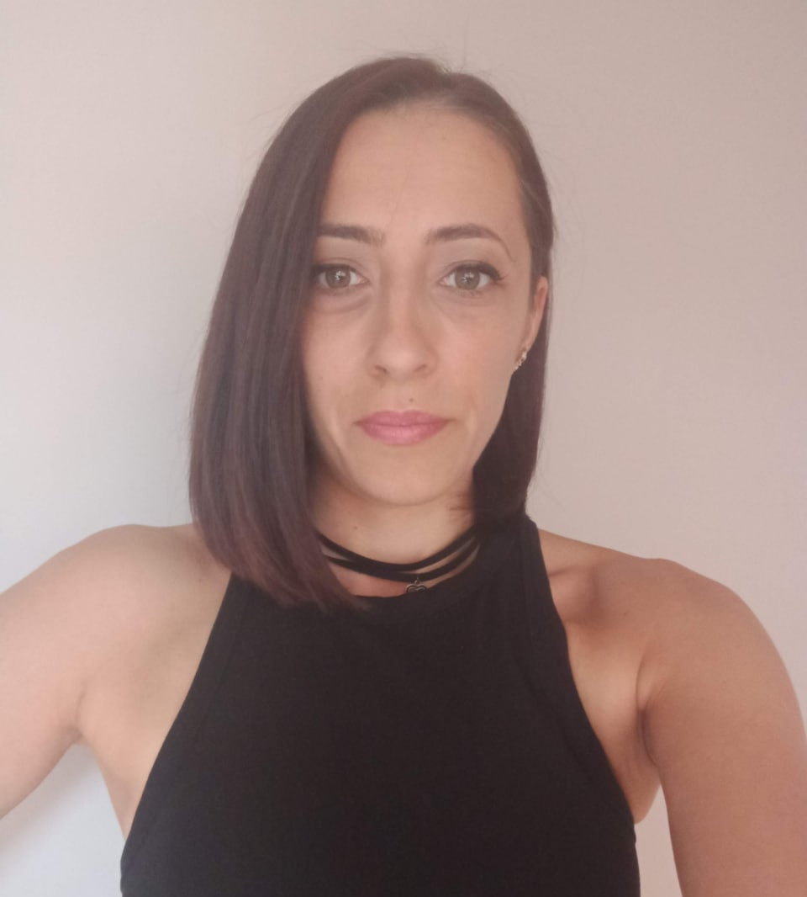
Veronika Vaneva
Graduated from the Medical University – Pleven
Technology trainer of many courses in programming, MS Office, Digital skills and others
Former Educational Director of SoftUni
Lecturer by vocation
Interests in workflow automation, as well as Java and C ++ technologies

Slide 23
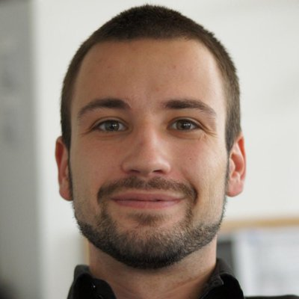
Angel Georgiev
Educational Director at SoftUni
15+ years of experience as a Technical Trainer and a Product Presenter
Founder and Business OWL at Znam.bе
Fluent in Java, C#, HTML/CSS, JavaScript, Python, PHP, SQL

Slide 24
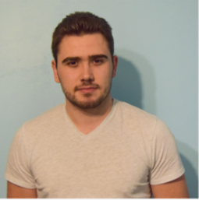
Slavi Kapsalov
Web Developer @ DraftKings
Technical Trainer @ SoftUni
100+ training sessions
Experience with JavaScript, Java, Python and etc.
Deep interests in automation of processes

Slide 25

Nikolay Kostov
Solutions Architect @ ZenCodeo
15+ years in IT
Takes an active role in the development of the https://judge.softuni.bg
Microsoft Certified Trainer
https://nikolay.it

Slide 26
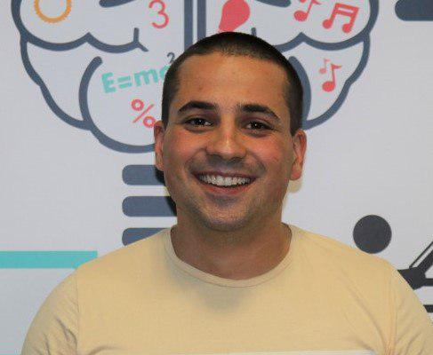
Martin Paunov
Java Developer at Virtual Racing School
Experience with Java, C++, C#
Technical Trainer @ SoftUni
Interested in Astrophysics

Slide 27
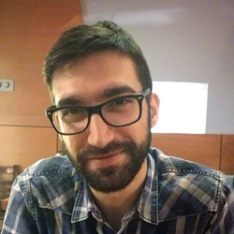
Viktor Kostadinov
Nearly 5 years experience as a technical trainer in the IT field
Head of the R&D Unit at Software University
Former Director of the Education Department
JavaScript enthusiast

Slide 28
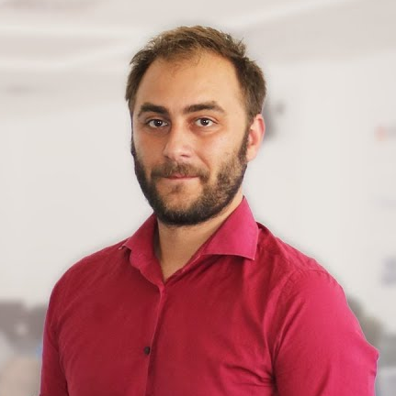
Doncho Minkov
Senior Full Stack Developer in SoftUni
10+ years in IT
8+ years of experience as a Technical Trainer in Telerik Academy
Front-end developer by heart
Software developer by need
Experience with all popular mobile platforms
Android, iOS, Windows
Fluent in Node.js, .NET, Angular, Java, C++
"30 under 30" - Forbes 2017 - Education

Slide 29
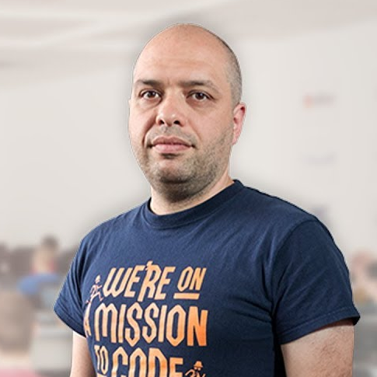
Stamo Petkov
Head Of Department at Information Services Plc.
Worked with various technologies
.NET and C#, BASIC, Pascal, Object Pascal, PHP
More than 15 years of experience
Experienced Technical Trainer

Slide 30
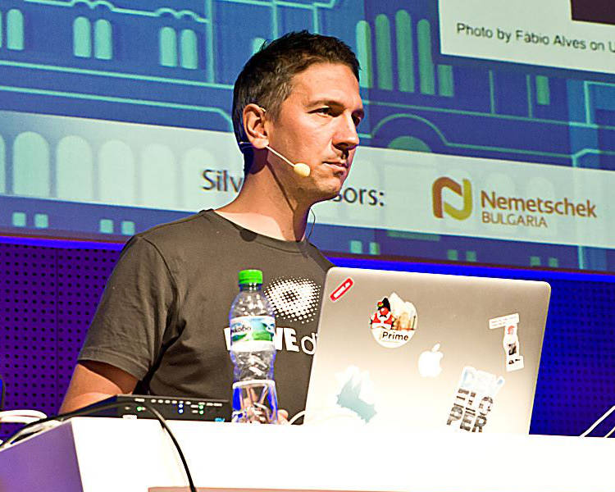
Lachezar Balev
Software engineer with 19+ years of real experience with different projects
Started developing with Java in the year 2000 in the form of J2SE 1.2
Works in REWE Digital Bulgaria on an architecture focused on microservices
Uses Java, TypeScript and Kotlin in his daily tasks
Personal website: http://balev.eu

Slide 31
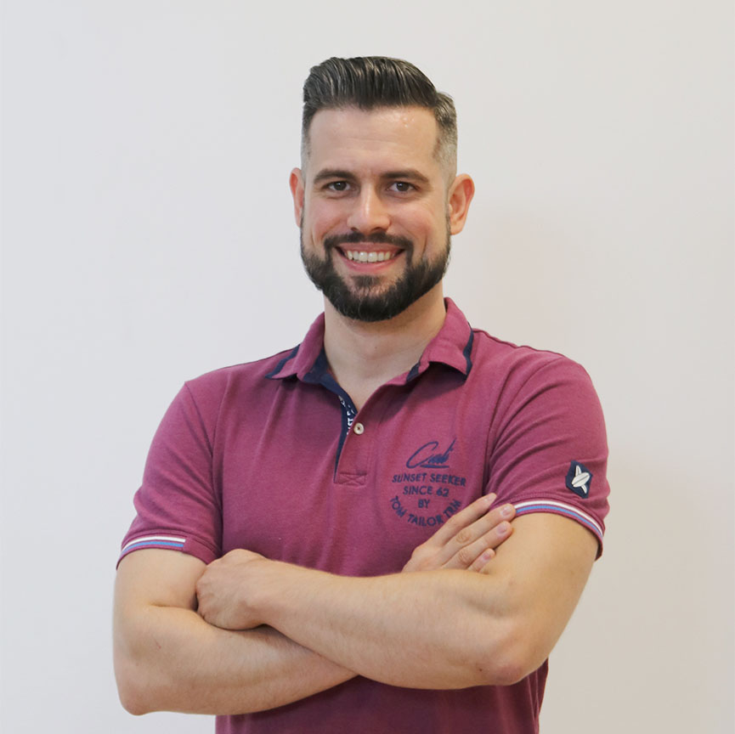
Ivaylo Papazov
Senior Full-Stack Developer and Team Lead @ Motion Software
Technical Trainer @ SoftUni
Experience in JS, C#, Node.js, React, ASP.NET MVC
TelerikAcademy Graduate

Slide 32
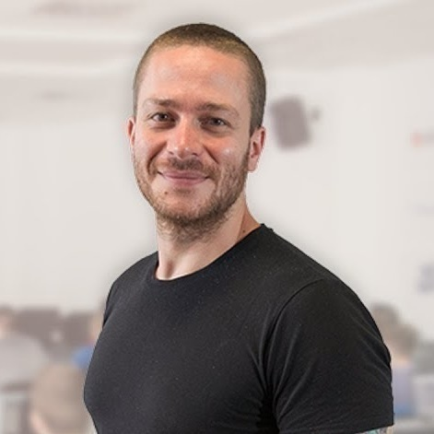
Ivaylo Kenov
Various job titles at the same time:
CTO @ SoftUni Dev Team
Technical Trainer @ SoftUni
Creator of open-source libraries for ASP.NET
MyTested.AspNetCore.Mvc
Mathematical competitions champion
Contacts:
https://github.com/ivaylokenov
https://linkedin.com/in/kenov

Slide 33
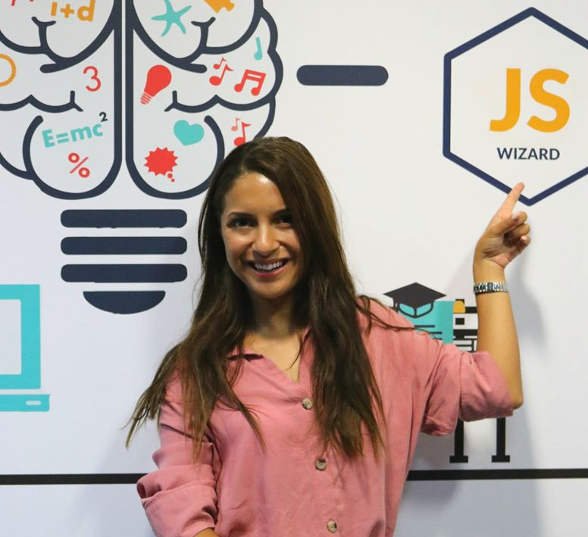
Antonia Atanasova
Passionate about Front-End Development
Technical Trainer in SoftUni
Web Development Freelancer
Contacts:
http://antoniaat.com

Slide 34

Learning Paths and Opportunities
The Choice is Yours

Slide 35
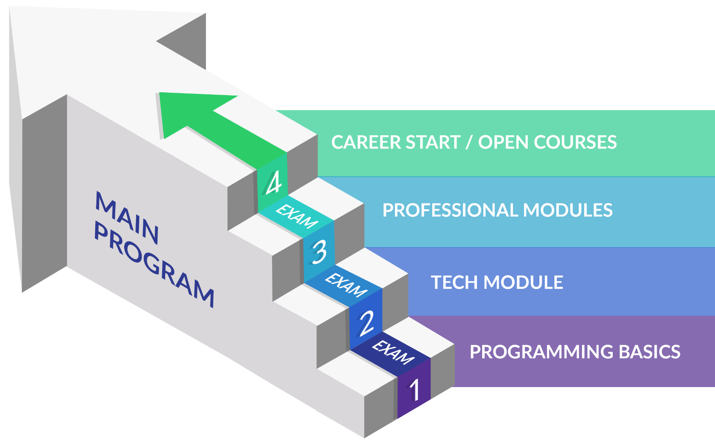
Software Engineering: Educational Program
Learning tracks: C#, Java, JavaScript, Python

Slide 36
Curriculum
Entry Module
Programming Basics
2 months
Fundamental Module
Fundamentals Module
4 months
Professional Modules
Java
C#
Python
JS
QA
12-16 months
https://softuni.bg/trainings/courses

Slide 37
Questions?
Notes:
37

Slide 38
Trainings @ Software University (SoftUni)
Software University – High-Quality Education, Profession and Job for Software Developers
softuni.bg, about.softuni.bg
Software University Foundation
softuni.foundation
Software University @ Facebook
facebook.com/SoftwareUniversity
Software University Forums
forum.softuni.bg
Notes:
38

Slide 39

License
This course (slides, examples, demos, exercises, homework, documents, videos and other assets) is copyrighted content
Unauthorized copy, reproduction or use is illegal
© SoftUni – https://about.softuni.bg/
© Software University – https://softuni.bg
Notes:
39

